Slide 1
Attracting Talent
Session 4/10
Part III

Slide 2
Recruitment

Slide 3
Recruitment
“searching for and obtaining potential job candidates in sufficient numbers and quality so that the organization can select the most appropriate people to fill its job needs” (Dowling & Schuler, 1990)
Recruitment aims to affect:
The number of people who apply for vacancies
The type of people who apply (skills and qualifications, values and preferences)
The likelihood that the people who apply will accept a position if offered

Slide 4
Leading companies invest heavily in recruitment
Selectivity requires a large applicant pool and highly efficient selection processes.
  In 2005 Infosys received almost 1.5 million job applications, tested approximately 160,000 candidates, and hired 15,000—whom the company considered the top 1%.
We will discuss selection next week…

Slide 5
Key Recruitment decisions
Should we fill a vacancy internally or search for candidates in the external market?
Where to look for applicants?
The content of the job and the type of person required
What to tell applicants?

Slide 6
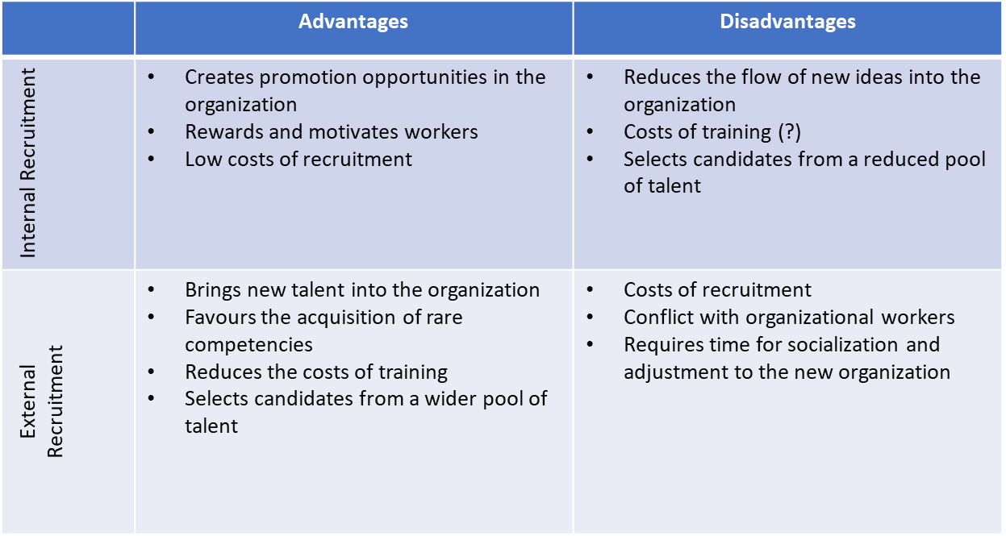
Leading companies use internal and external labour markets

Slide 7
Leading Companies use a range of recruitment sources
Direct applicants
Referrals
Local/national (?) newspaper (Gardian? FT? Daily Telegraph? Professional journals? e.g. Nursing Times or the Journal of Pharmacy)
E-recruitment (jobs.ac.uk; facebook; linkedin; company websites; etc.)
Employment agencies
  Public (Job Centre)
  Temporary employment agencies
  Recruitment Consultants
  Headhunters/Executive Search Consultants
University “milk-round” (Key for attracting high potential employees)

Slide 8
Leading Companies analyse the efficacy of their recruitment sources
Where do our top performers come from?
Where do our high potential employees come from?
Where can we reach more diverse groups of workers?
Etc.

Slide 9
Defining the talent required – competency models
“the work-related personal attributes, knowledge, experience, skills and values that a person draws on to perform their work well” (Roberts, 1997)
Competency model
Produces generic and concise job profiles
Identifies sets of competencies that are seen as important across the organization, such as planning and organizing, managing relationships, gathering and analyzing information and decision making.
Advantages
Oriented for future needs
More economic and less time consuming
Limitations
Difficult to apply as line managers often do not see the benefits of the competency framework
The competencies do not set clear links to what the business is aiming to achieve

Slide 10
Leading companies manage candidates’ expectations effectively
What is the right dose of realism?
Be positive about the job leaving any negative aspects out?
Include all the negative aspects of the job (technical complexity, unsocial hours, etc)?

Slide 11
Realistic job previews
The aim is to help candidates get a better understanding of the job, the organization and the culture so that they can make an informed choice about their application.
Helps shape the psychological contract and avoid contract breach

Slide 12
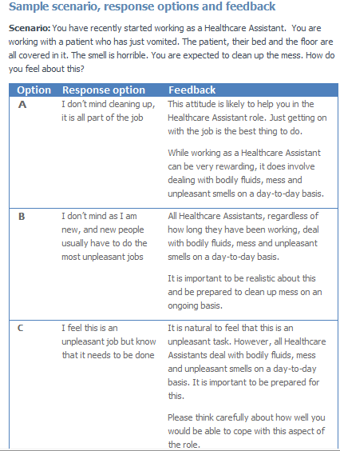

Slide 13
References
Connelly, B. L., Certo, S. T., Ireland, R. D., & Reutzel, C. R. (2011). Signalling theory: A review and assessment. Journal of Management, 37(1), 39-67.
Edwards, M. R., & Edwards, T. (2013). Employee responses to changing aspects of the employer brand following a multinational acquisition: A longitudinal study. Human Resource Management, 52(1), 27-54.
Lievens, F. (2007). Employer branding in the Belgian Army: The importance of instrumental and symbolic beliefs for potential applicants, actual applicants, and military employees. Human Resource Management, 46(1), 51-69.
Rodger, A (1952) The Seven-point Plan, National Institute of Industrial Psychology, London
Rodrigues, R., Guest, D., & Budjanovcanin, A. (2013). From anchors to orientations: Towards a contemporary theory of career preferences. Journal of Vocational Behavior, 83(2), 142-152.
Schein, E. H. (1996). Career anchors revisited: Implications for career development in the 21st century. The Academy of Management Executive, 10(4), 80-88.

